Slide 1
Agent
Authentication
Go to Dashboard
Franchisee
Yes
Unauthenticated Home
Sign In Page
Is User Logged IN?
Owner
Pass
No
Call Microsoft Auth
Stay on Sign In Page
Not Registered
No
Sign In
Forget Username/Password
Register

Slide 2
Visible to Everyone
(In Franchise)
Lead Process
No
Does client want representation
Convert button
Are there forms required?
No
No
Yes
1. Not Yet (Send is Gray/Pending)
2. Cancelled (Send is Green)
Is Lead Assigned?
Yes
LeadPage
Hot
(Keep on contacting)
List of Forms
Form Name | Send | Cancel
Has customer completed document?
Yes
Yes
Lead will be visible as an opportunity in Opportunity Page
Lead contact info will appear in contacts page
Completed docs will be visible as attachments
Visible to assigned User/Team
Contact Lead
Is Hot or Cold?
Send Adobe Sign document
Cold
(Backlog)
Last Contact (Date)

Slide 3
Opportunity

Slide 4
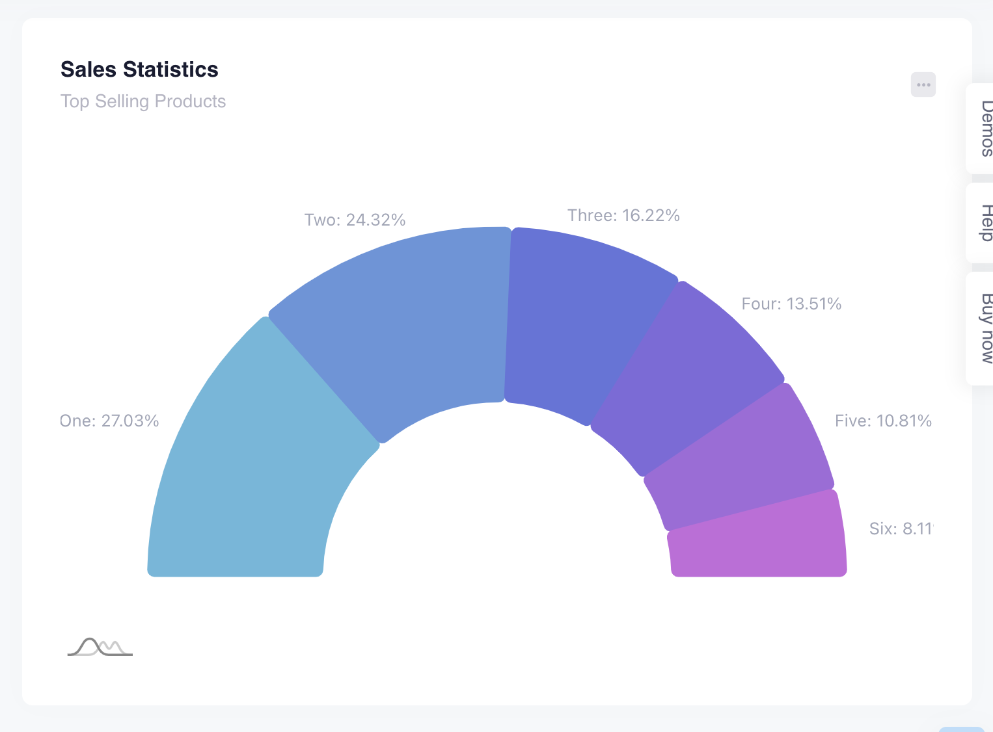
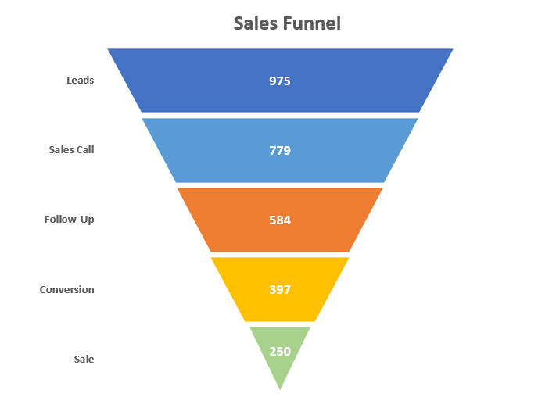
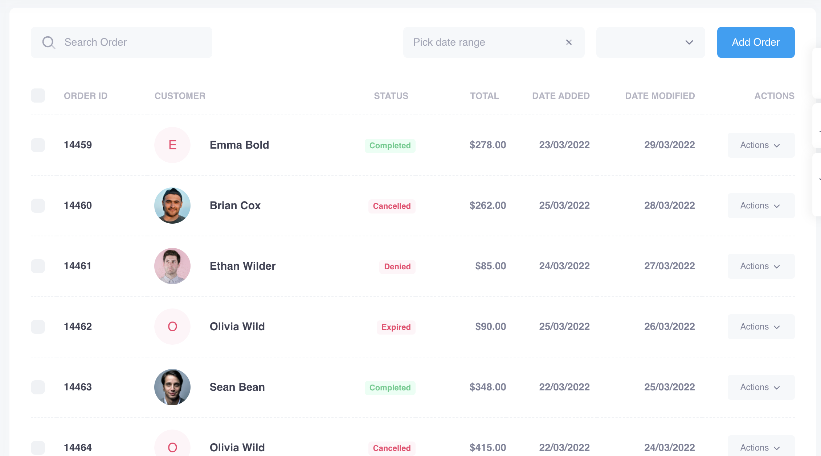
Property Management
Dashboard
Me
Sales
Approvals
Marketing
Education
Organization
Settings
Leads
Contacts
Opportunities
Transactions
Forms
Properties
Cold
Hot
Opportunity
Transaction

Slide 5
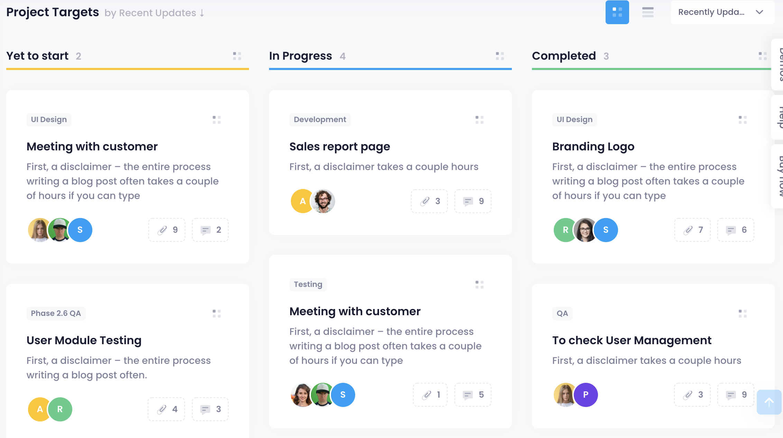
Property Management
Dashboard
Me
Sales
Approvals
Marketing
Education
Organization
Settings
Leads
Contacts
Opportunities
Transactions
Forms
Properties
My Opportunities
Create

Slide 6
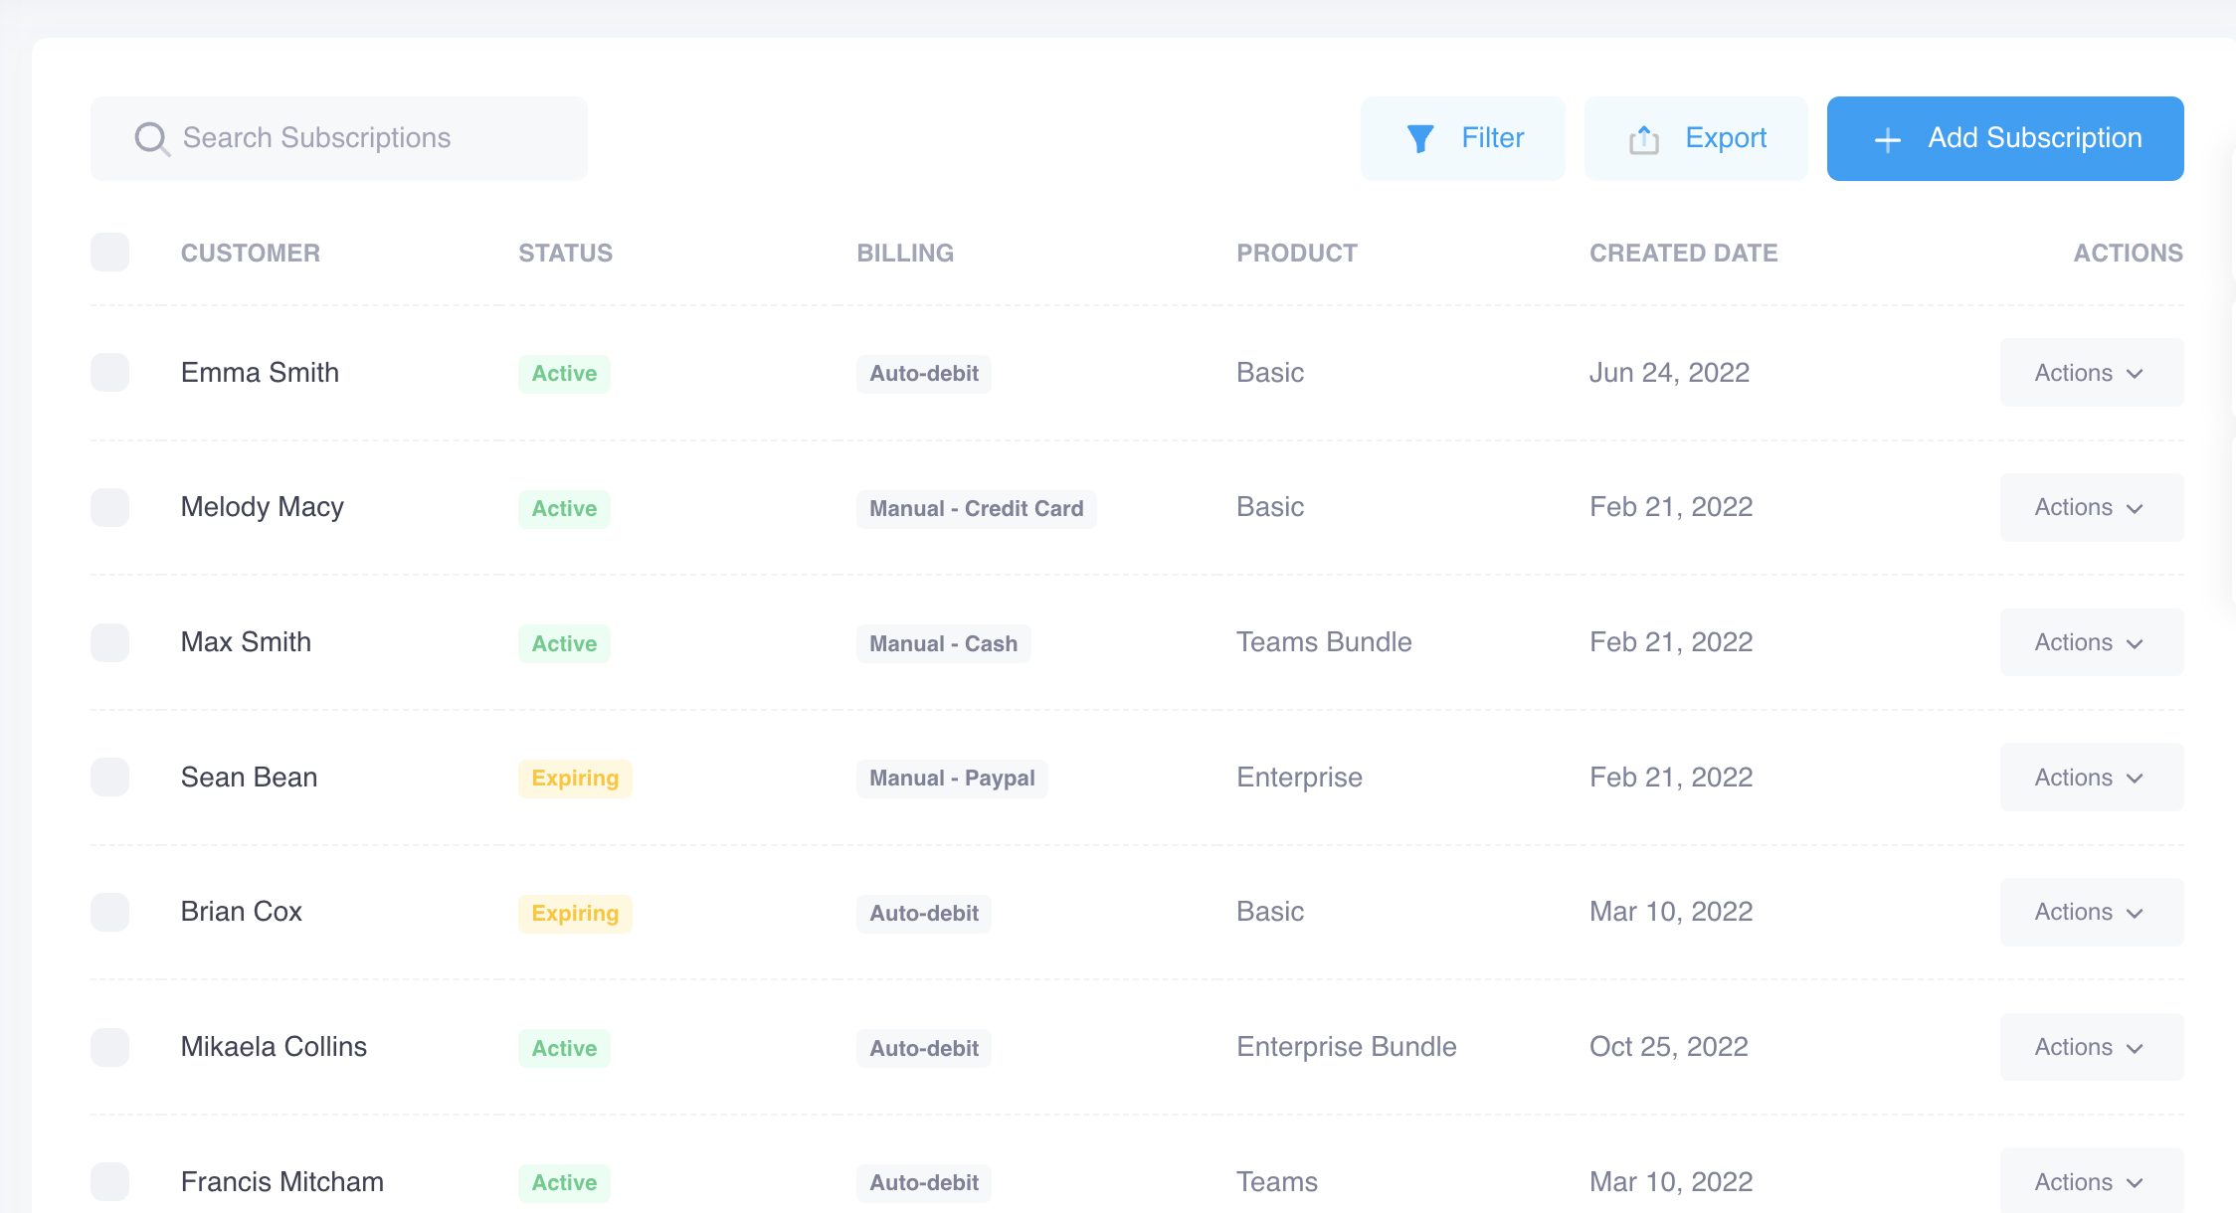
Property Management
Dashboard
Me
Sales
Approvals
Marketing
Education
Organization
Settings
Leads
Contacts
Opportunities
Transactions
Forms
Properties
Form
Title
Action
Opportunity
Transaction
Created By
Franchise Required
State Required

